Slide 1


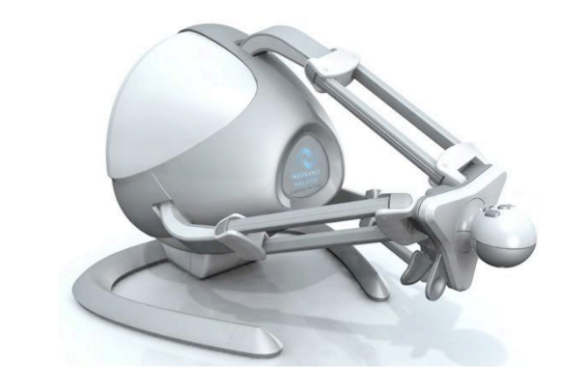
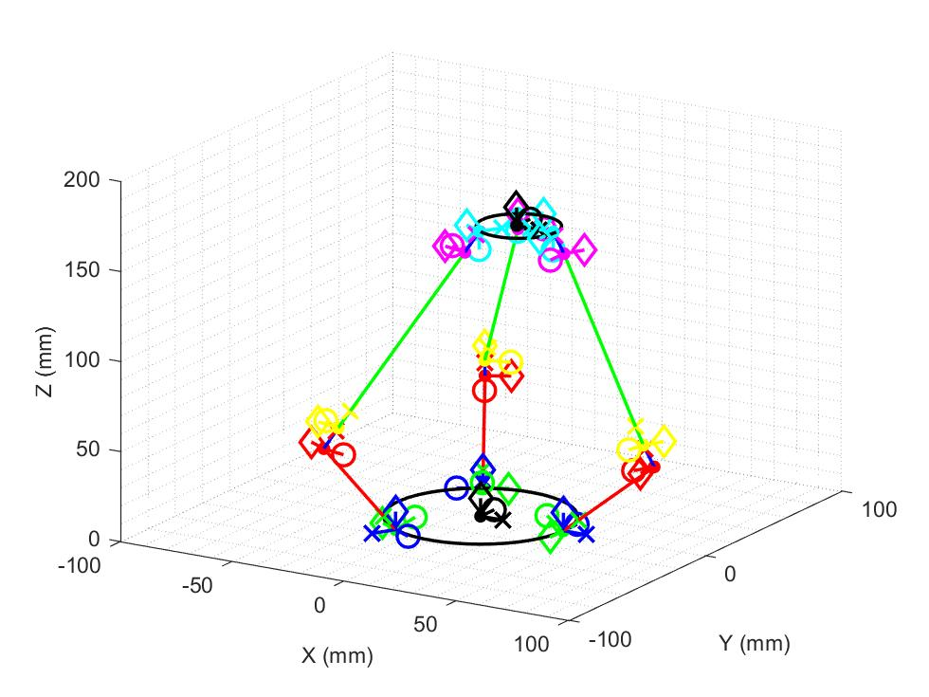
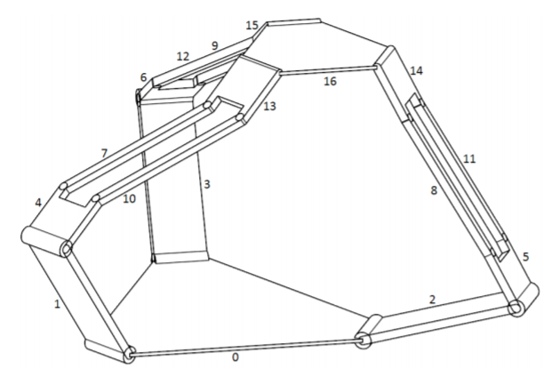
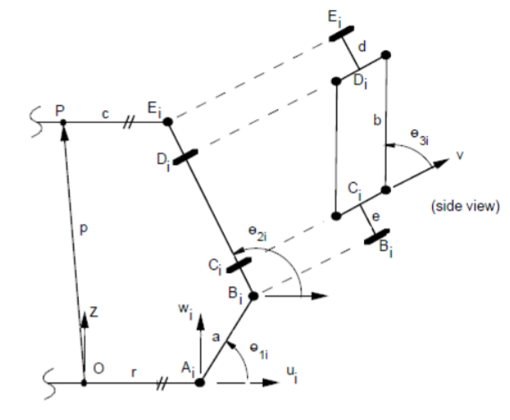
Analysis of Novint Falcon Haptic Device as Manipulator
Sichao Zhang, Peiguang Wang
Rice University, Houston, Texas
Motivation
Simulation
Novint Falcon is a parallel haptic device that has only three transitional DOFs. In this study, we analyze the Novint Falcon as a 3-DOF manipulator to observe its kinematics and dynamics properties.
Implement MATLAB codes for the kinematic configuration of the robot.
Make the end effector move in the expected routine and generate a video demo.
Apply control laws to drive the robot back to expected position.
Kinematics
Result
Figrue 3 shows a normal pose of the robot in kinematic configuration. The whole motion is shown in the demo video.
Figure 1. Novint Falcon Haptic Device [1]
Approach
Forward and Inverse Kinematics
Based on Tsai and Stamper’s research on the kinematics configuration [2].
Build DH parameters from the general base to the end effector for each leg.
Solve the inverse kinematics and find the optimal solution in each iteration.
Figure 3. Normal Pose
Conclusion
Simulation shows the end effector moves as expected, which verifies the feasibility of kinematics in former research.
Controls are applied to make the robot move to expected states.
Reference
Figure 2. Kinematics of Novint Falcon [2]
[1] Application of the Novint Falcon haptic device as an actuator in real-time control, Daniel J. Block, et. al. DOI: 10.2478/pjbr-2013-0017 JBR · 4(3) · 2013 · 182-193
[2] A Parallel Manipulator with Only Translational Degrees of Freedom, Lung-Wen Tsai, Richard E. Stamper. Technical Research Report
[3] Dynamic Identification of the Novint Haptic Device, Nima Karbasizadeh, et. al. International Conference on Robotics and Mechatronics. October 26-28, 2016, Tehran, Iran.
Dynamics and Control
Based on Nima Karbasizadeh team’s work on the dynamic identification of the Novint Falcon. [3]
Apply different control laws to observe the displacement responses.

